Slide 1
DSA
Types Of Array

Slide 2
Introduction
There are two types of arrays in java.
Single-dimensional arrays
Arrays that have only one dimension. The elements of a single-dimensional array are stored in a contiguous block of memory.
Multidimensional arrays
Arrays that have more than one dimension. The elements of a multidimensional array are stored in a multidimensional grid of memory.

Slide 3
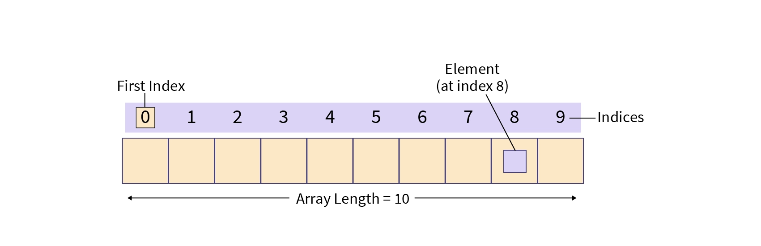
1-D Array

Slide 4
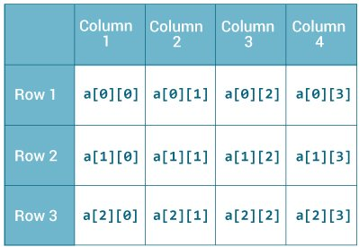
2-D Array

Slide 5
Thanks For Watching

